Slide 1
Regions affecting expression
SD
-12 -8 -4
+37
Promoter
+1
-35 -10
Notes:
In a nutshell, I’ve highlighted the important regions of the gene that are the primary determinants of translation level.

Slide 2
The simplest translation models
Notes:
If you just want to know the chemical structure of the protein product emerging from translation, the genetic code is sufficient to model the system. However, often what we want to know quantitatively how much of that protein will get made in the cell, and for this we must somehow model translation. This turns out to be quite challenging, but let’s start with the most basic model.

Slide 3
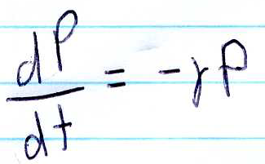
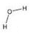
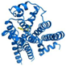
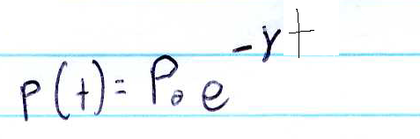
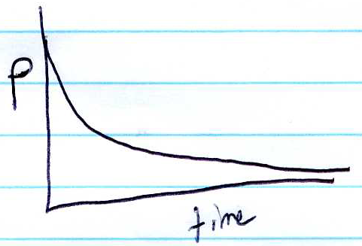
Protein degradation (γ_{p})
Species P of some specific protein molecule
P₀ = 3
Notes:
Suppose we have a droplet of water containing a protein. We can describe the number of molecules of that species as a variable P, and suppose that at some initial time point P has the value P0 = 3 protein molecules. A natural value would be in the range of 1 to 100,000 molecules of P in one cell. If this is truly just protein in water, then the only thing that can happen is that a protein could get degraded.
*
There are all sorts of reasons why a protein might degrade. The peptide bond can spontaneously hydrolyze by reaction with water, UV light could result in photochemical damage to it, and it might spontaneously unfold or aggregate. In a real cell, under rapid growth conditions, the doubling time of the cell usually dominates any active degradation process, but keep in mind that there are many distinct mechanisms involved in the degradation of a protein in the cell, but they are all usually lumped together into one term that is assumed to be first order with respect to the protein concentration.
*
Thus we describe the change in P over time as a simple first order differential equation.
*
That can be solved for P as a function of time as being the initial concentration of P times e to the –gamma*t.
*
If we plot that we see the classic and simple exponential decay behavior where P assymptotically goes to zero over time.

Slide 4
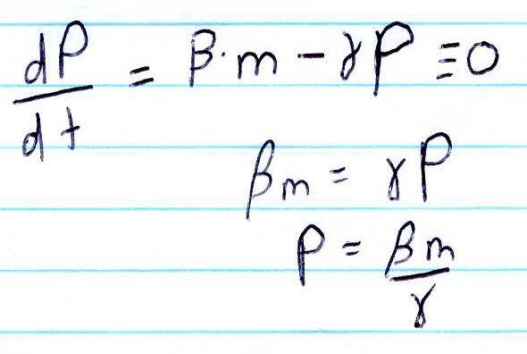
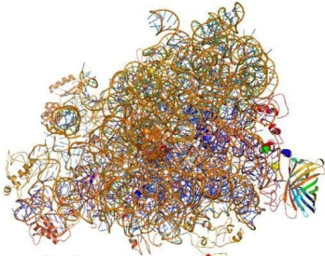
Protein synthesis (β_{p})
null
m mRNA molecules
GFP
Notes:
Similarly, we can model the rate of translation according to simple first-order kinetics. The change in P as a function of time is the sum of two processes: synthesis and degradation. The synthesis term is proportional to the mRNA concentration, and the degradation term is proportional to the amount of protein present. If the system achieves a steady state, then the protein concentration no longer changes, and the rate of change of P becomes zero.
*
So we set this equation equal to zero, and then we can solve for the concentration of P at this steady state by just doing some simple algebrae.
*
And we find that P is equal to beta*m over gamma. This very simple math turns out to be a good model of constitutively-expressed proteins under vegetative growth conditions. The reason for this is that degradation rates are dominated by growth of the cells and dilution of the cytoplasm, and this rate is on a similar timescale to the rate of protein synthesis. However, most of the detail is hidden under this term ‘beta’ that make it difficult to relate this math back to sequence.
*
In a real-world situation, we are trying to express some protein and hit some specific expression level in the cell. We have three “easy” dials we can turn to alter the expression: we can change the promoter, the rbs, or the codon usage of the gene.

Slide 5
“Engineering biology”
AGATCTtccctatcagtgatagagattgacatccctatcagtgatagagatactgagcacGGATCTGAAAGAGGAGAAAGGATCTatggcgagtagcgaagacgttatcaaagagttcatgcgtttcaaagttcgtatggaaggttccgttaacggtcacgagttcgaaaTAA
α
K_{eq}
β
γ
k_{cat}
ΔG_{fold}
Model parameters
Biophysical parameters
DNA sequence that will give these parameters
Notes:
We can write this differential equation models to describe the system incorporating any detail we want, and from this we can do computer simulations that will tell us what that system will do. The challenge here is that we need to map the parameters in the model to biophysical parameters and then relate these parameters to the sequence. In the Transcription chapter, we talked about how transcription rates can be related to binding constants for sigma70 and various other terms. We saw that the sequence of the promoter is locally encoded and thus promoter activity tends to be insulated from downstream and upstream sequences. It was fairly easy to describe promoters as Parts and stamp a relative expression level on each promoter part that predicts its relative strength. A similar approach can be tried for ribosome binding sites.

Slide 6
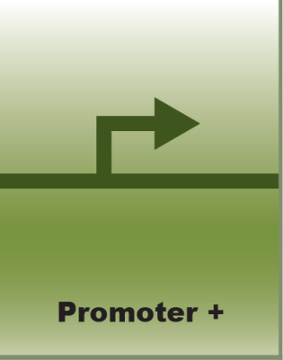
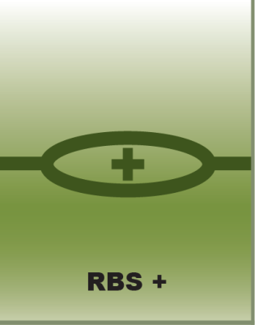
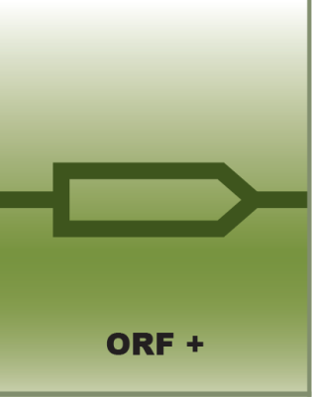
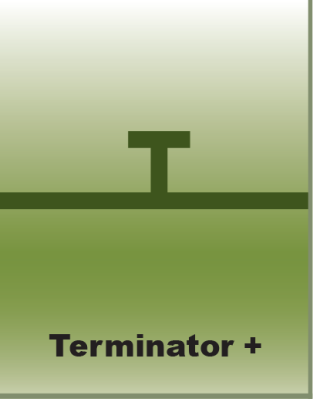
“Standardized” Parts
Notes:
RBS ‘parts’ can be generated in much the same way that promoter parts are generated. You start with a composition of promoter, rbs, coding sequence, and terminator, then apply saturated mutagenesis to the RBS region. If your CDS part is readily assayable, then you can pick colonies with distinct expression levels, sequence them, and from this you have a set of rbs parts. The test for the ‘modularity’ of these parts is done by putting the family of RBS parts in different context.
*
Here we have a family of 7 rbs parts placed upstream of either RFP in red or lacZ in blue. All constructs have the same promoter and terminator, they just differ by the choice of orf and choice of RBS part. Notice that the rank order of the ribosome binding sites is different for the two proteins. For perhaps half of them, which correspond to the weaker RBS’s, the ratios of the different activity levels seems fairly proportionate, but at the higher levels things get quite out of wack. This very simple method of encapsulation turns out to have some validity. Perhaps 50 percent of the variability is accounted for. However, it is clear that the junction between the rbs and the coding sequence for simple ribosome binding sites is not trivially modular. Before we move on, let me make clear that we are discussing translation in prokaryotes here, and the sensitivity of the 5’ UTR is far less pronounced in eukaryotes. In yeast, it turns out that tuning ribosome binding sites has much less effect on gene expression.

Slide 7
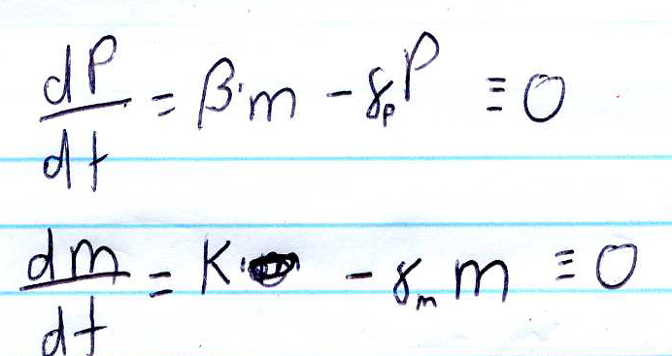
What terms in these differential equations can be tuned by switching out an RBS part?

Slide 8
What terms in these differential equations can be tuned by switching out a promoter part?

Slide 9
Biophysical models of translation
PMID 19801975
Notes:
In prokaryotes, it is well known that variation in sequence upstream of an open reading frame has a big effect on translation. Modifying this region of a part is usually the best place to alter expression levels in the cell. Modeling the relationship between sequence and expression level can be handled in multiple ways,

Slide 10
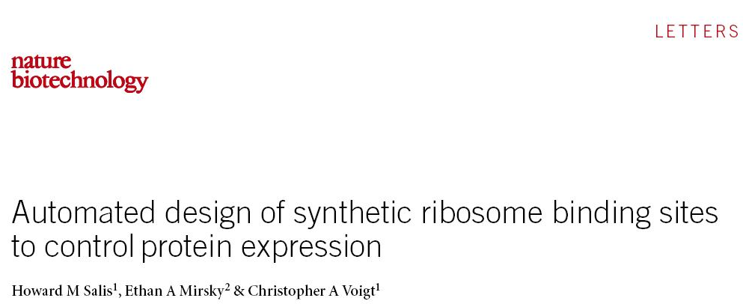
Notes:
but in this paper, relative expression levels are predicted using models that include notions of RNA secondary structure.

Slide 11
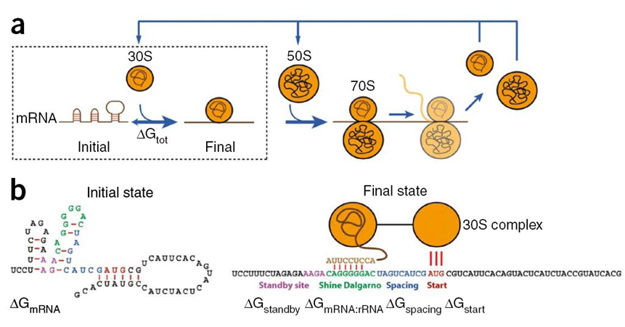
Biophysical model
Notes:
In the Salis approach, the mRNA molecule is modeled according to distinct attributes known to affect gene expression. Just as in transcription, the initiation of translation begins with a simple binding equilibrium between the shine delgarno site on the mRNA and the 30S subunit of the ribosome. Salis use a biophysical model to correlate this binding equilibrium with structural properties of the RNA sequence. In this model, for any one RNA sequence, the molecules exist in one of two states. Either the shine-delgarno region is available for binding, or it is occluded by a hairpin. If we want to account for the fraction of mRNAs that are competent for initiation, we need to model the fraction of these species quantitatively. The stability of any secondary structures in the 5’ UTR that involve the shine-delgarno sequence result in this occluded state, and the stability of that complex can be calculated pretty accurately using mfold models. Salis breaks apart 4 different aspects of the sequence: the stability of the upstream region called the standby site, the affinity of the shine delgarno region for the 30S subunit, how far apart the start codon and shine delgarno are from one another, and whether it has an ATG or GTG start. And they combine these parameters to get a total energy difference between the occluded and open states.

Slide 12
Biophysical model
Optimal Watson-Crick base pairing energy
Two values: one for GTG and one for ATG
Empirically derived term correlating with “best” WC bp of rbs and start, one value for each spacing
mFold calculated stability of 4bp upstream of found RBS
Lowest-energy “hit” from mFold of entire structure
Notes:
This term describing the affinity of the Shine delgarno sequence for the rRNA is based on the stability of the watson-crick duplex in this region of the mRNA. The models for calculating these energies are well-established and this attribute is believed to be the dominant determinant of relative gene expression levels. The deltaG start has only two potential values, one if the start codon is GTG and another if it is ATG. This spacing term deals with the distance of the shine delgarno sequence from the start codon. Typically the shine-delgarno is placed 8 bp away from the start codon, so this spacing value has a limited number of integer values and these were empirically determined. The standby term deals with the stability of the region upstream of the RBS, and this is specific to the sequence of that region. Its value can be estimated by mFold calculations. Finally, there is the deltaGmRNA term. This is the term that estimates the fraction of molecules in which the shine-delgarno is hairpinned on itself. They calculate this by taking the lowest-energy hit from the mFold calculation of the entire mRNA structure that involves that region of the sequence.
*
I’ve put stars by the components of this model that are also captured in the part model. The mRNA:rRNA stability is defined by that specific sequence of mRNA in the RBS region of the mRNA molecule, and thus this value is captured by the part model. Whether the start codon is GTG or ATG and its distance from the RBS are also captured by the Part model. To some degree, the standby energy is captured in the part model in the sense that if these interactions are all local to the sequence upstream of the shine-delgarno, they will be independent of the sequence downstream of the start codon. So, to some degree this energy is captured in the part concept as well. The remaining term that distinguishes the occluded and non-occluded populations is definitely not captured in the part concept and accounts for much of the improved accuracy of this model relative to the simple part model.

Slide 13
Which of the delta G terms would be encapsulated by the Part model?

Slide 14
Biophysical model
*
Optimal Watson-Crick base pairing energy
*
Two values: one for GTG and one for ATG
*
Empirically derived term correlating with “best” WC bp of rbs and start, one value for each spacing
*
mFold calculated stability of 4bp upstream of found RBS
*Value would be a property of an RBS part
Lowest-energy “hit” from mFold of entire structure
Notes:
This term describing the affinity of the Shine delgarno sequence for the rRNA is based on the stability of the watson-crick duplex in this region of the mRNA. The models for calculating these energies are well-established and this attribute is believed to be the dominant determinant of relative gene expression levels. The deltaG start has only two potential values, one if the start codon is GTG and another if it is ATG. This spacing term deals with the distance of the shine delgarno sequence from the start codon. Typically the shine-delgarno is placed 8 bp away from the start codon, so this spacing value has a limited number of integer values and these were empirically determined. The standby term deals with the stability of the region upstream of the RBS, and this is specific to the sequence of that region. Its value can be estimated by mFold calculations. Finally, there is the deltaGmRNA term. This is the term that estimates the fraction of molecules in which the shine-delgarno is hairpinned on itself. They calculate this by taking the lowest-energy hit from the mFold calculation of the entire mRNA structure that involves that region of the sequence.
*
I’ve put stars by the components of this model that are also captured in the part model. The mRNA:rRNA stability is defined by that specific sequence of mRNA in the RBS region of the mRNA molecule, and thus this value is captured by the part model. Whether the start codon is GTG or ATG and its distance from the RBS are also captured by the Part model. To some degree, the standby energy is captured in the part model in the sense that if these interactions are all local to the sequence upstream of the shine-delgarno, they will be independent of the sequence downstream of the start codon. So, to some degree this energy is captured in the part concept as well. The remaining term that distinguishes the occluded and non-occluded populations is definitely not captured in the part concept and accounts for much of the improved accuracy of this model relative to the simple part model.

Slide 15
RBS Calculator
https://salis.psu.edu/software/
ATGAGCAATGATCCCGGAAATGAGGTCTCATCGTTGTATCCCCCTCCACCTCCTTATGTCAAGTTTTTTACTCAATCAAATTTAGAGAAGCTACCCAAGTATAAGGAGAAGAAGGCAGCA
Limitations:
Accuracy is +/- factor of 2
Only gives relative translation rate, not absolute
Doesn’t make predictions that involve changing the ORF sequence
Assumes translation initiation is under thermodynamic control, not kinetic control
The RNA secondary structure calculation only takes into account the single “best hit”, not the partition function of all hits
Does not take into account RNAse degradation or self-splicing behavior
Notes:
Here I’ve indicated the URL for the RBS calculator, so you can check it out online. You can try copying and pasting this sequence into it, or any other ORF.
* The claims made about these predictions are that the accuracy is within a factor of 2 for *relative* translation rate.
Note that it does not predict the absolute translation rate, and the actual rate would depend on growth conditions.
The designs generated by RBS calculator are 5’ UTR sequences. It will not, for example, suggest that you change the codon usage in the first few amino acids of a protein, and sometimes such mutations are what needs altering to make a protein express well.
The RBS calculator is the current state-of-the-art in predicting translation rates, but several attributes of the model could be expanded upon to increase its accuracy. For example, the calculator assumes that translation initiation is under thermodynamic control and thus can be described by deltaG’s. It is unclear whether a pseudo-equilibrium is ever achieved during translation and thus may actually be under kinetic control meaning that it would need to be described in terms of rate constants instead of equilibria.
Additionally, there could be higher refinement to the RNA secondary structure calculation. Currently, it only takes into account the single “best hit” from mFOLD. In practice, there could be 10 different structures all similarly populated, and an accurate prediction of the non-occluded fraction could require a description of the partition function for all distinct conformers.
The model also only deals with issues of secondary structure and interactions with the ribosome. It does not take into account various proteins in the cell that could bind to and alter the conformation of the mRNA. It also neglects the activity of RNAses that could cleave the RNA into different molecules.
These represent several ideas that have been proposed for how to optimize this algorithm, and ultimately what features are the right features to accurately model expression levels is something that will have to be demonstrated empirically. The RBS calculator is the first attempt at assembling our biochemical knowledge about translation and encapsulating it in a software design tool, and this approach will continue to improve accuracy as the modeling is refined.

Slide 16
‘Big Data’
approaches to model translation
PMID 19359587
Notes:
The challenge of reliably expressing proteins has been around for decades. Because protein expression is a common activity in industry, there is a large driver for understanding the relationship between sequence and expression level. In recent years, the availability of GFP and the ability to synthesize gene-length DNAs at scale has led to a ‘big data’ approach to the problem. I use this term ‘big data’ loosely. As of yet, we aren’t dealing with terabyte-scale data in synthetic biology, but we would if we could. The essential idea of these experiments is that a very large number of datapoints is collected, and then software is used to construct models that encapsulate the patterns present in this data.

Slide 17
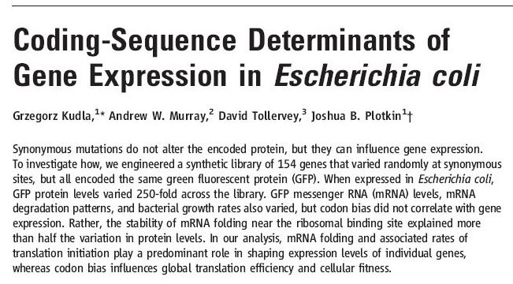
Notes:
In this study, Plotkin and coworkers synthesize a large family of GFP genes and attempt to describe the observed variation in function to the sequence of each gene.

Slide 18
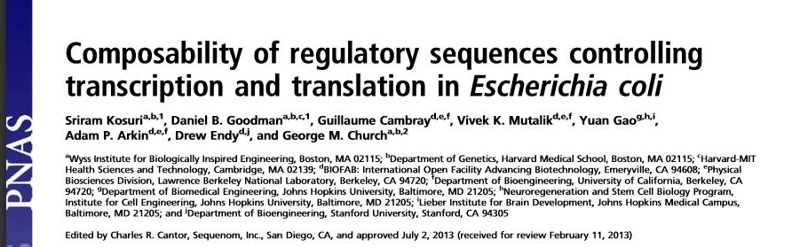
PMID 23924614
Notes:
Since the time these slides were made, a second and more detailed study has been performed by Church and coworkers. The conclusions are similar to the Plotkin study, but the refinement and techniques are more advanced. I recommend that you read both papers.

Slide 19
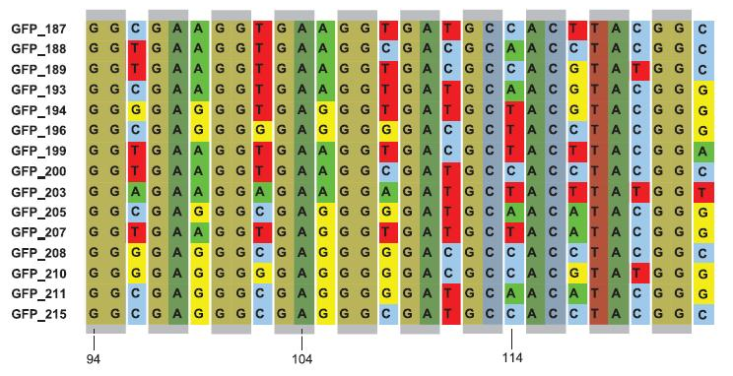
Random GFPs
154 genes that varied randomly by altering codon usage
Place under a T7 promoter or Ptrc (normal σ₇₀ promoter)
Get 250-fold range of fluorescence activity
Notes:
In the Plotkin experiment, they synthesize 154 variants of GFP in which each variant uses different codon usage at each position. Thus, every one of these genes encodes the exact same protein sequence, but each one is encoded by a different DNA sequence. They place each synthetic GFP gene under the control of either a T7 promoter or a Ptrc promoter. Even though all these genes have the same regulation and encode the same protein, there is a 250-fold range in fluorescence activity amongst the constructs. From a 50,000-foot view of this experiment, the most obvious take home point is that the diversity of expression levels in prokaryotes is as sensitive to codon usage as it is to upstream regulation. Ribosome binding site libraries result in a very similar spectrum activity as do codon variation libraries, and thus either route is a means of adjusting gene expression levels in the cell.

Slide 20
Why would you expect codon usage to affect gene expression?

Slide 21
CAI: codon adaptation index
Codon usage is not random—some codons are used much more than others
Codon usage correlates with tRNA abundance
Overexpression of rare tRNAs improves expression of genes with rare codons
Use of “rare” codons slows the rate of elongation during translation
CAI can be calculated for a coding sequence, see http://genomes.urv.es/CAIcal/E-CAI; PMID 18230160
Ranges between 0 and 1
They look to see if CAI calculations correlate with GFP activity
Neither full-length CAI, CAI for first 42 bp, or number of “bad” codons correlates with expression levels
Notes:
The Plotkin study goes much further in terms of trying to explain the pattern of expression levels as they relate to the underlying sequence of each construct. One very popular idea that is somewhat debunked by this study is that codon usage is a major determinant of expression level. When you examine genome sequences and tabulate out how many times a genome uses each of the 64 codons, you find that codon usage is far from equal, and different in different kingdoms.
*
It is also well-established that codon usage in an organism is correlated with tRNA abundance. For example, E. coli does not use the arginine codons AGA and AGG much and this correlates with the fact that the tRNA that decodes these codons is poorly expressed in the cell.
*
Anecdotally, if you overexpress these rare tRNAs in the cell you often can improve the expression of genes containing rare codons suggesting that codon usage may be a major determinant of gene expression.
*
The explanation for this would be that rare codons slow the rate of elongation during translation and thus the amount of product generated.
*
The CAI is a value readily calculated for a particular codon sequence. It has values between 0 and 1. It is defined as the geometric mean of the weight asssociated to each codon over the length of an open reading frame. It is a measure of the bias towards commonly-used codons. It does not take into account the location of the rare codons in the sequence, but simply the count of each type of codon and the frequency of that codon in the organism.
*
Surprisingly, Plotkin shows that this CAI index does not correlate well with observed expression level. They try to correlate the full-length CAI, the CAI for just the first 42 bp, or the number of really rare codons, and none of these statistically correlates with their data. This result is somewhat surprising, and superficially it seems in conflict with the frequently-encountered observation that tRNA overexpression improves yield. One potential explanation is that slow codons are tolerated in some regions of the mRNA and not others, and we can only understand this by modeling the stochastic kinetics of the elongation process.

Slide 22
Role of secondary structure, etc.
The folding energy of the entire mRNA was not significantly correlated with fluorescence
Folding energy of the first third of the mRNA was strongly correlated
Region from–4 to +37 relative to start predicted folding energy explained 44% of the variation based on T7 promoter set
For Ptrc set, it explains 57% of variation
That region is encapsulated within the RBS calculator’s ΔG_{RNA} calculation, but it isn’t altered by the design algorithm
Notes:
Of the algorithms chosen, no one parameter predicts a majority of the observed variation. However, secondary structure in the 5’ end of the mRNA turns out to be one major determinant.
When they do secondary structure prediction to the entire mRNA molecule, that folding energy does not significantly correlated with fluorescence
If they limit the calculation to the first third of the mRNA, they see a strong correlation with fluorescence values
And this is most pronounced when the algorithm is applied to the region from–4 to +37 relative to start codon. It can account for 44% of the variation based on T7 promoter set
For Ptrc set, it explains 57% of variation
That is the region encapsulated within the RBS calculator’s ΔG_{RNA} calculation, but it isn’t altered by the design algorithm

Slide 23
Role of secondary structure, etc.
The folding energy of the entire mRNA was not significantly correlated with fluorescence
Folding energy of the first third of the mRNA was strongly correlated
Region from–4 to +37 relative to start predicted folding energy explained 44% of the variation based on T7 promoter set
For Ptrc set, it explains 57% of variation
That region is encapsulated within the RBS calculator’s ΔG_{RNA} calculation, but it isn’t altered by the design algorithm
Also examine predicted transcription termination, global GC content, length of the longest rare-codon stretch
Number of predicted ribonuclease (RNase) E cleavage sites predicts 4.7% of variation
mRNA levels varied three times less than corresponding fluorescence variation
Notes:
They also examine predicted transcription termination, global GC content, length of the longest rare-codon stretch and all can explain some small component of the variability
Their study also looked at RNAse sites. For example, the number of predicted ribonuclease (RNase) E cleavage sites predicts 4.7% of variation
They also looked at the mRNA levels, and surprisingly they have about 1/3 the variation of fluorescense levels. Considering that all these mRNAs are generated from the same promoter, this observation is somewhat surprising and suggests that translation and transcription may be more coupled than is commonly assumed.
In general, the take home point is that many different attributes of the mRNA structure end up influencing gene expression levels. Though the underlying mechanisms affecting gene expression all relate to biophysical parameters and conventional biochemical interactions which are well-understood, it is the complexity itself that makes the problem challenging.

Slide 24
Why would the amount of mRNA be variable just changing codon usage?

Slide 25
What determines γ rates?
Steady state mRNA concentrations are a combination of synthesis rate and degradation rate
Most mechanisms described are specific regulatory mechanisms employed by specific genes
However, the sequence determinants for such mechanisms are low, and the number of mechanisms is high, so it is likely that alternate mechanisms inadvertently get incorporated into arbitrarily designed coding sequences
The most common of these are the ribonucleases (RNAse E, ribonuclease III, and RNase J1/RNase J2, etc.) which all have loose sequence determinants
Similarly, WC bp’s between an mRNA of interest and another RNA in the cell can either stabilize or cause degradation of an RNA
Notes:
In our derivation, steady state mRNA concentrations (which is what these sorts of experiments measure) are a combination of synthesis rate and degradation rate. This paper reviews the various things that happen to mRNAs that alter their degradation rates
Most mechanisms described are specific regulatory mechanisms employed by specific genes
However, the sequence determinants for such mechanisms are low, and the number of mechanisms is high, so it is likely that alternate mechanisms inadvertently get incorporated into arbitrarily designed coding sequences
The most common of these are the ribonucleases (RNAse E, ribonuclease III, and RNase J1/RNase J2, etc.) which all have loose sequence determinants
Similarly, WC bp’s between an mRNA of interest and another RNA in the cell can either stabilize or cause degradation of an RNA

Slide 26
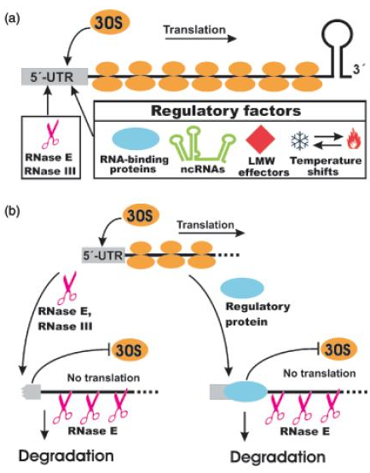
Coupling of translation and m
5’UTRs can be occupied by 30S subunit of RBS, other RNA-binding proteins, ncRNAs, and secondary structure (and sometimes small molecules, but that is likely rare in sequence space)
mRNAs that aren’t actively translated are more susceptible to degradation
So, the dM/dt parameter γ and the dP/dt parameter β are not independent
Translational control mechanisms tend to be low-gain effects (2x), but they could add up to throwing off other calculations
Notes:
Regulatory factors or otherwise affect the initiation of translation
If you muck with translation initiation, then the rest of the mRNA is bare and is prone to degradation, resulting in a coupling of RNA abundance and translation rate

Slide 27
Bicistronic Operons
PMID 23474465
Notes:
An altogether different approach to controlling translation levels is to employ specialized parts.

Slide 28
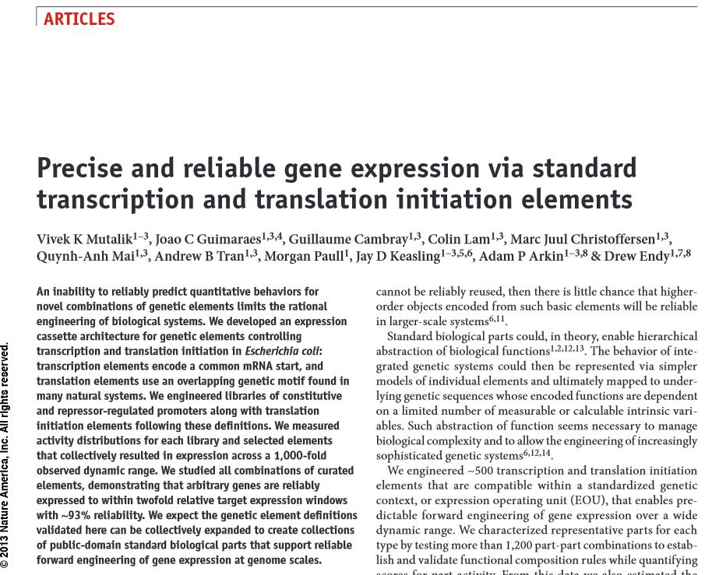
Notes:
In this study from the BioFAB, the authors employ bicistronic operons to make the biology behave more like simple models. Previous studies, such as the Plotkin one, show that much of the variation in expression can be eliminating by fusing a (about 37 bp) constant sequence to the 5’ end of an open reading frame. Since most aspects of gene expression deal with sequence entirely in the 5’ UTR or first 37 bases of coding sequence, locking in the sequence of this region has the desired effect of eliminating most of the causes of variable expression. However, many proteins will not tolerate an N-terminal fusion, and there are also concerns about reusing longer stretches of exact DNA sequence in a design due to the potential for recombination and excision of the introduced genes. In contrast, the bicistronic method uses the normal start codon for the protein, but it places a second initiation site just upstream.

Slide 29
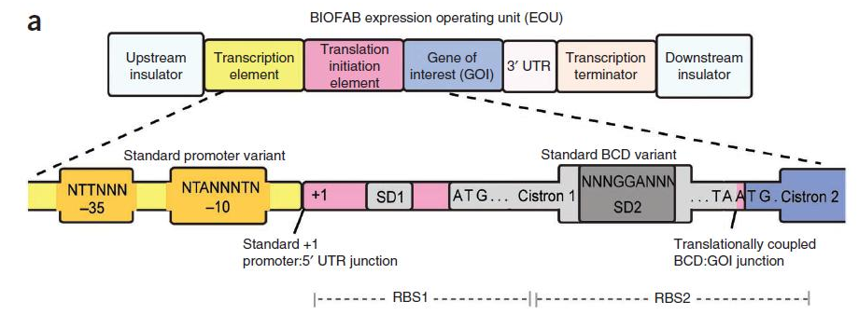
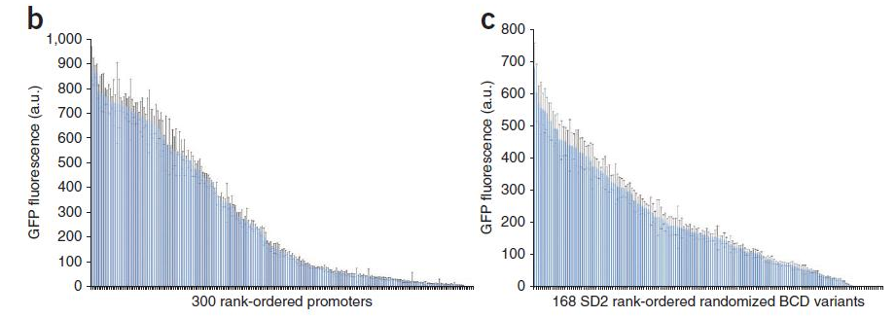
Promoter and RBS Libraries
Notes:
Their constructs look like this. They place an upstream ‘insulator’ sequence to prevent any transcription from entering this region of the DNA. They then put in a conventional promoter, the sequence that gets transcribed, then a constant 3’ UTR, terminator, and more insulation. The novelty of the construct is within the region that is transcribed. The 5’ UTR contains two ribosome binding sites. The first one, SD1 initiates translation of Cistron 1 which encodes a short peptide. The second ribosome binding site, SD2 is superimposed over Cistron 1 and defines the strength of translation of the downstream gene encoded by cistron 2. The idea here is that translation initiation is an uncertain process, but when two ORFs are co-cistronic in close proximity like this, the same ribosome will proceed from the first coding sequence to the next without re-equilibrating. Thus, there is only one round of dissolving the secondary structure for the construct, and initiation from the second cistron will be more reliable.
*
They design libraries based on this bicistronic sequence in which cistron 2 is the GFP open reading frame. They saturate key -10 and -35 regions of the promoter and the ciston1 sequence around the second ribosome binding site. They screen through the diversity in the same way we’ve seen before with consistitive promoters and from this they construct family of promoters sequences and SD2 sequences that span 3 orders of magnitude in expression.

Slide 30
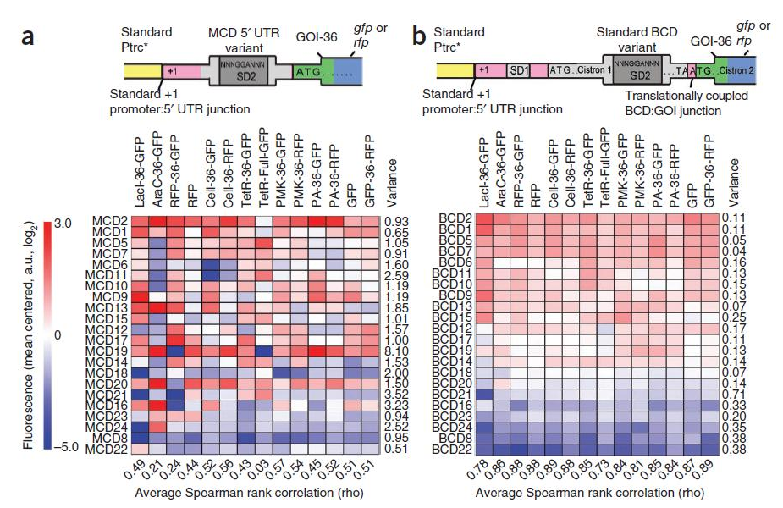
Insulation by bicistronic expression
Notes:
To test their hypothesis that this will better regulate translation, they make a direct comparison of their bicistronic constructs to single-ciston constructs. In figure A, the mRNAs will contain an SD2 sequence, the first 36 base pairs of arbitrarily-chosen genes, and then either RFP or GFP. In figure B, the SD2 sequence is placed in the bicistronic context, but the same 36-bp arbitrary-protein sequence is the N-terminus for each encoded protein, as is the GFP or RFP. Thus, the two sets only differ by variation in the 5’ UTR. What they observe is very poor correlation with the conventional constructs. However, with the bicistronic constructs, there is a tight correlation between choice of SD2 sequence and the expression level.

Slide 31
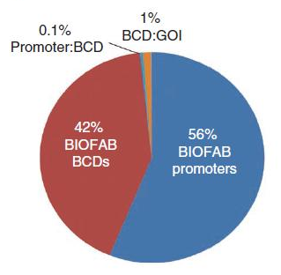
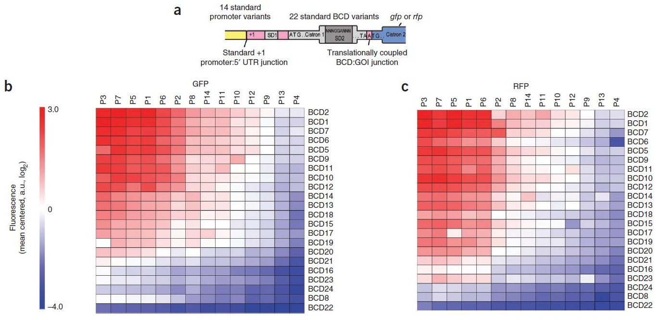
Promoter and RBS Variation
Notes:
They also construct a 14 promoter cross 22 ribosome binding site library of constructs for GFP (on the left) and RFP (on the right). In these plots they show the different chosen promoters from left to right and the different-strength ribosome binding sites from top to bottom. The relative fluorescence of each strain is indicated by the heat map.
*
When they employ simple translation models to describe this variation, they find that they can account for most of the variation in these experiments by considering just two parameters: a strength for each promoter and a strength for each RBS.

Slide 32
Do bicistronic operons address the problem of 5’ UTR secondary structure?

Slide 33
Do bicistronic operons address the problem of translational coupling?

Slide 34
If you went into the wetlab today and wanted to change the expression level of your gene to half its original level, what are your options?

